Slide 1
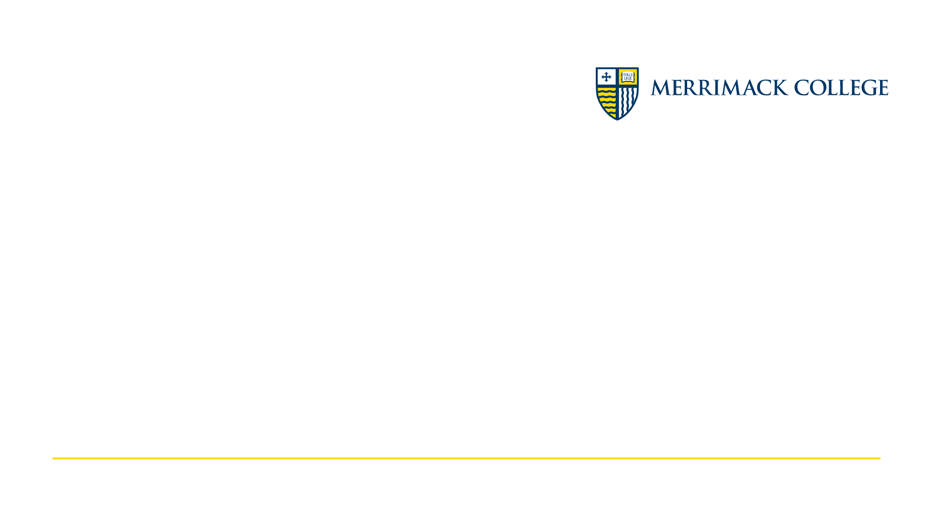
CSC6013 - Algorithms and Discrete Structures
Data structures - Lists, Stacks, Queues, and Dictionaries - Week 2
Prof. Paulo Fernandes, Ph.D.

Slide 2

25% of the course
Week 2
This is a very fast paced course, so this is the the first full course topic: Data Structures: Lists, Stacks, Queues, and Dictionaries

Slide 3
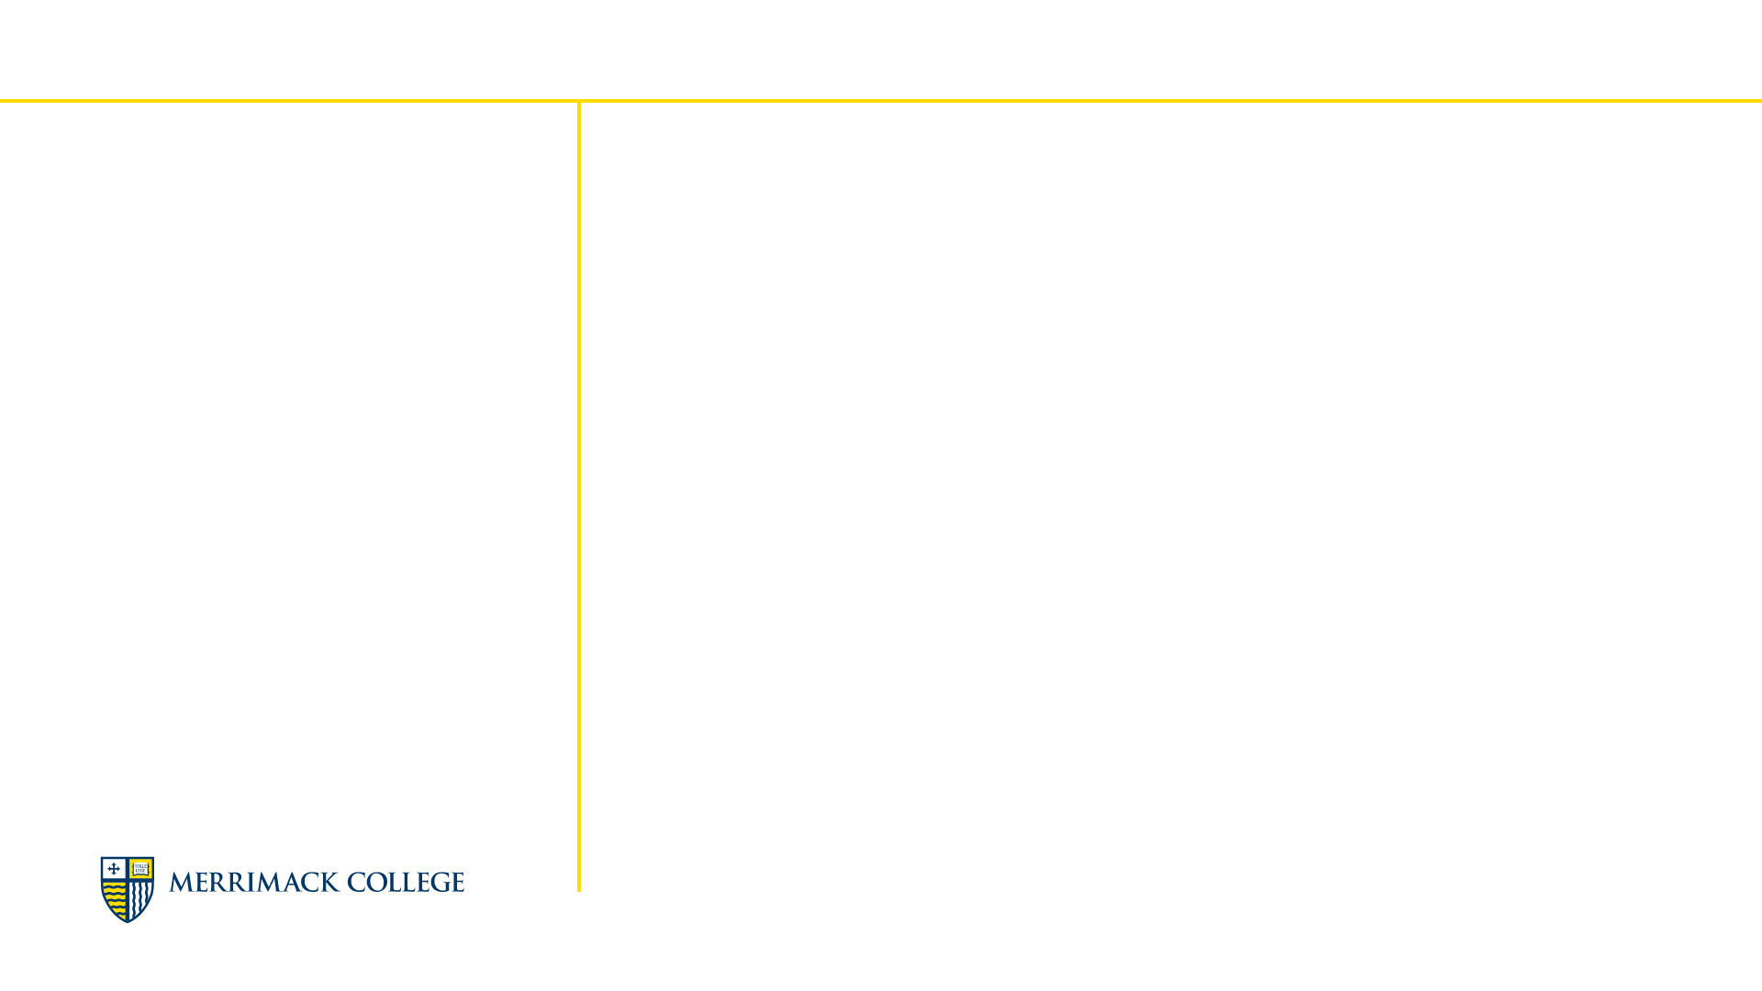
Agenda
Week 2 Presentation
Data Structures: Lists, Stacks, and Queues
Data Structures Basics
What are lists, stacks, and queues?
Implementing with arrays or linked lists
In Python
Queues
Stacks
Data Structures: Dictionaries (and hash)
Hash Tables
Hash tables to index
Python Dictionaries
Dictionaries in action
Examples of dictionaries
When use a dictionary

Slide 4
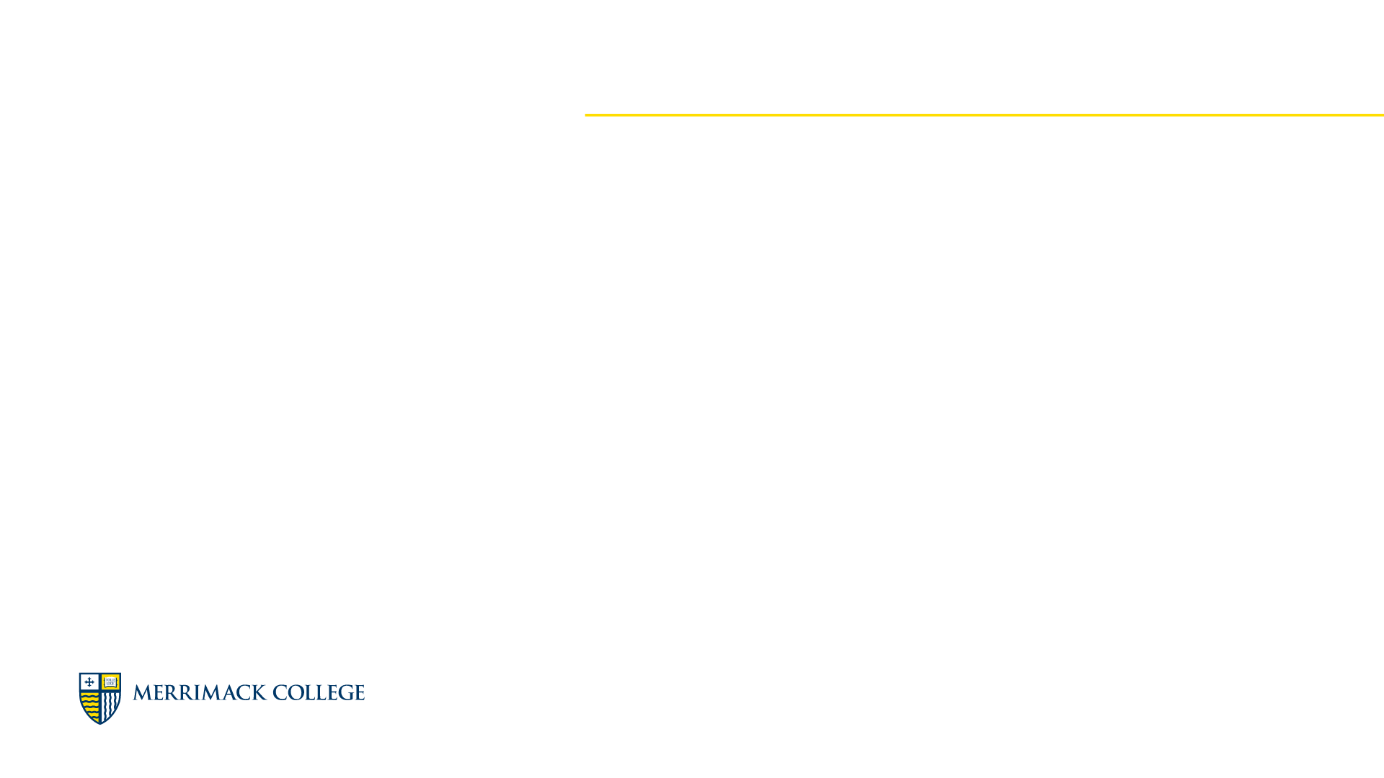
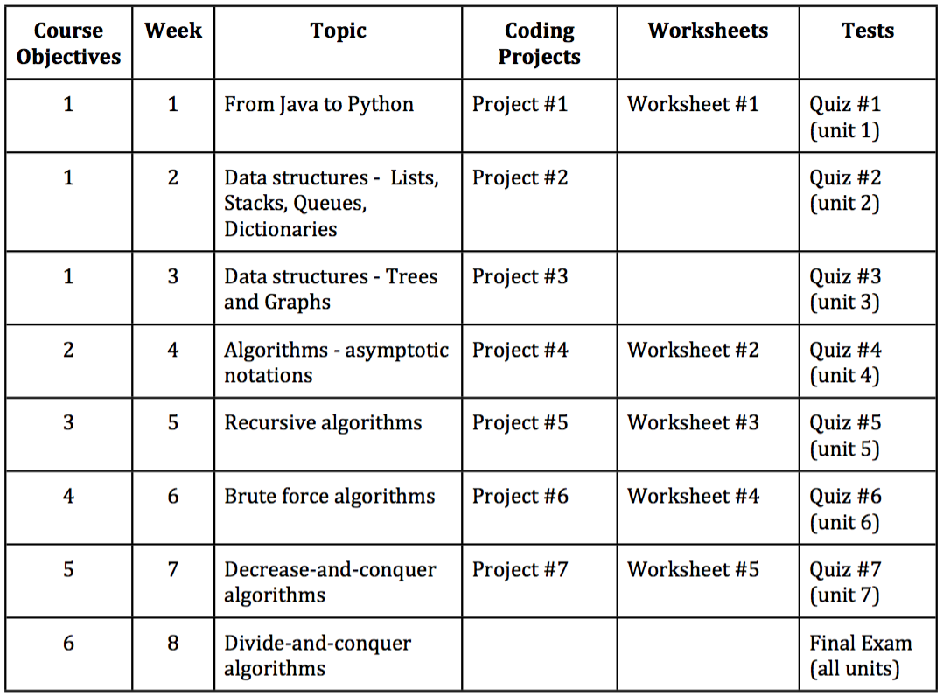
Course Introduction
8-week course
Course Timeline
Read the Syllabus!!

Slide 5

Week 2
Data Structures: Lists, Stacks, Queues, and Dictionaries
Now that you know Python…
An old Greek philosopher once said: "I only know that I don't know anything". Well, assuming that that is false and someone can to some extent actually know something, you can tell that you know Python. However, Python is just a language, the data abstractions that we use is the knowledge.

Slide 6
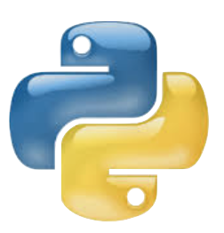
Data Structures
A data structure is an abstraction of how data is structure: a data structure is a data abstraction
Data Structures: Lists, Stacks, and Queues
When I say to you 19788375000 that is data
… but +1 (907) 883-5000 you realize that this is a phone number … if you assume that eleven digits are stored and that represents a phone number in US or Canada - that is an abstraction, in other words, data to whom we assigning a structure
In CS there are some usual data structures that allows the abstraction of some concepts to provide (usually) a faster, less demanding, access to data

Slide 7
Data Structures
What are lists, stacks, and queues?
Data Structures: Lists, Stacks, and Queues
Arrays - same kind of variable stored sequentially in memory allowing index access
Lists - in CS, any form of organized content that be accessed in an orderly fashion, but not necessarily by a simple indexing procedure
Queues - a special kind of list in which elements can only be inserted by one end, and the elements removed can only be removed by the other end of the list
Stacks - a special kind of list in which elements can only be inserted and removed by one end of the list

Slide 8
Data Structures
What are lists, stacks, and queues?
Data Structures: Lists, Stacks, and Queues
Arrays - same kind of variable stored sequentially in memory allowing index access
"George" | "John" | "Paul" | "Ringo"
0 | 1 | 2 | 3
Lists - in CS, any form of organized content that be accessed in an orderly fashion, but not necessarily by a simple indexing procedure
"George" | "John" | "Paul" | "Ringo"

Slide 9
Data Structures
What are lists, stacks, and queues?
Data Structures: Lists, Stacks, and Queues
Queues - a special kind of list in which elements can only be inserted by one end, and the elements removed can only be removed by the other end of the list - FIFO
"George" | "John" | "Paul" | "Ringo"
Stacks - a special kind of list in which elements can only be inserted and removed by one end of the list - LIFO
"George" | "John" | "Paul" | "Ringo"

Slide 10
Data Structures
Implementing with arrays or linked lists
Data Structures: Lists, Stacks, and Queues
Arrays and Lists
In Python all that is somewhat encapsulated and the programmer is not fully aware of what is going on “under the hood”
Queues and Stacks
There are trade-offs to implement queues and stacks either with arrays or linked lists, so Python do not necessarily keep it “under the hood” (unless you want to use a Python list or a package and ignore how this these data structures are actually implemented)

Slide 11
Data Structures
Implementing with arrays or linked lists
Data Structures: Lists, Stacks, and Queues
For an Array
Inserting at the beginning
Inserting at the end
Removing from the beginning
Removing from the end

Slide 12
Data Structures
Implementing with arrays or linked lists
Data Structures: Lists, Stacks, and Queues
For a Linked Lists
Inserting at the beginning
Inserting at the end
Removing from the beginning
Removing from the end

Slide 13
Data Structures
Implementing with arrays or linked lists
Data Structures: Lists, Stacks, and Queues
For an Array
Accessing an element
Accessing all elements

Slide 14
Data Structures
Implementing with arrays or linked lists
Data Structures: Lists, Stacks, and Queues
For a Linked List
Accessing an element
Accessing all elements

Slide 15
Data Structures
Implementing with arrays or linked lists
Data Structures: Lists, Stacks, and Queues
Operation | for arrays | for linked lists
Insert at the beginning | “Scootch over” all | Just adjust pointers
Insert at the end | simple | simple
Remove at the beginning | “Scootch over” all | Just adjust pointers
Remove at the end | simple | simple
Visit the e element | immediate | laborious
Visit all elements | sequentially is ok | sequentially is ok

Slide 16
Data Structures
Implementing with arrays or linked lists
Data Structures: Lists, Stacks, and Queues
Queues implemented with arrays
Insert at the end
Remove at the beginning - bad!
Access the beginning
Stacks implemented with arrays
Insert at the end
Remove at the end
Access the end
Queues implemented with linked lists
Insert at the end
Remove at the beginning
Access the beginning
Stacks implemented with arrays
Insert at the beginning
Remove at the beginning
Access the beginning

Slide 17
Data Structures
Implementing Queues in Python
Data Structures: Lists, Stacks, and Queues
There are many options:
Using Python Lists
Simple, but not necessarily efficient
Using the LinkedList class saw in the previous class, or another implementation you own
Complete control over the code
Using a built-in collection, for example, from queue package the Queue class
reliable , but not necessarily what you need

Slide 18
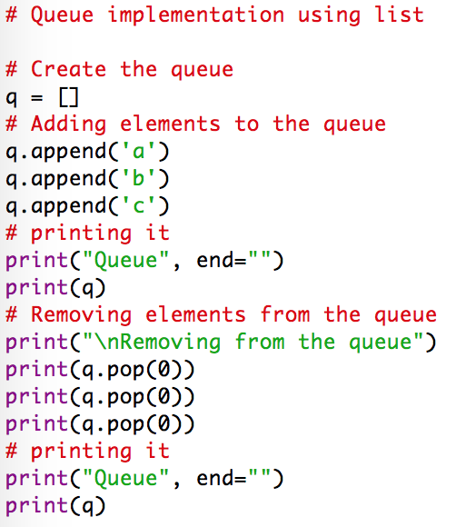
Data Structures
Implementing Queues in Python
Data Structures: Lists, Stacks, and Queues
Using Python Lists
Create the queue
q = []
Insert at the end
q.append(d)
Remove and access at the beginning
d = q.pop(0)
Beware: calling pop(0) to an empty queue returns an IndexError

Slide 19
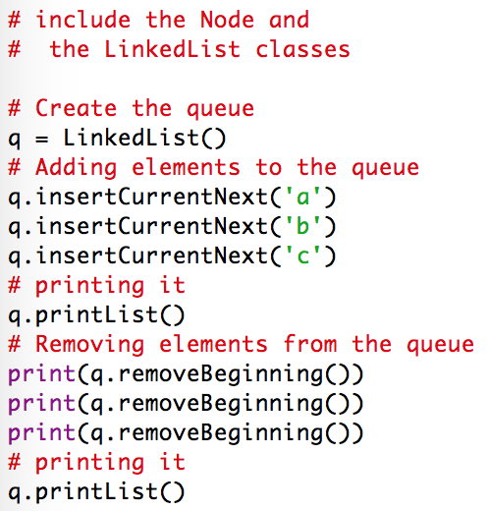
Data Structures
Implementing Queues in Python
Data Structures: Lists, Stacks, and Queues
Using Using the LinkedList class saw in the previous class
Create the queue
constructor
Insert at the end
Keep current at the last element
Remove and access at the beginning
If removing from an empty queue it returns None

Slide 20
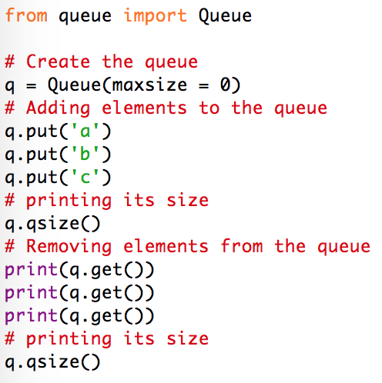
Data Structures
Implementing Queues in Python
Data Structures: Lists, Stacks, and Queues
Using a built-in collection, for example, from queue package the Queue class
Create the queue
constructor
Insert
q.put(d)
Remove and access
d = q.get()
Beware: calling get() to an empty queue may cause a wait behavior
Complete ref here

Slide 21
Data Structures
Implementing Queues in Python
Data Structures: Lists, Stacks, and Queues
Using Python Lists
You use a Python list as a black box, you don’t know what is going on really, but it is simple
Using the LinkedList class saw in the previous class, or another implementation you own
You know what is going on, but you may not know if the implementation is the best possible one
Using a built-in collection, for example, from queue package the Queue class
You know you are using an efficient and reliable tested implementation, but it may have features and details you do not need/want, or miss others you need/want

Slide 22
Data Structures
Implementing Stacks in Python
Data Structures: Lists, Stacks, and Queues
There are many options:
Using Python Lists
Simple, but not necessarily efficient
Using the LinkedList class saw in the previous class, or another implementation you own
Complete control over the code
Using a built-in collection, for example, from queue package the LifoQueue class
reliable , but not necessarily what you need

Slide 23
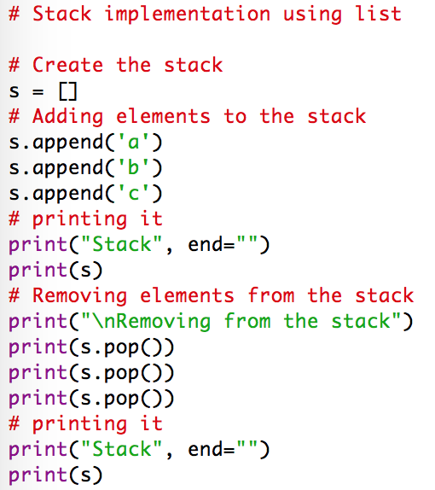
Data Structures
Implementing Stacks in Python
Data Structures: Lists, Stacks, and Queues
Using Python Lists
Create the stack
s = []
Insert at the end
s.append(d)
Remove and access at the beginning
d = s.pop() (the pop default is the last element
Beware: calling pop() to an empty stack returns an IndexError

Slide 24
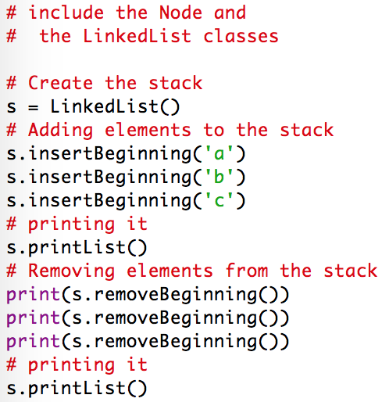
Data Structures
Implementing Stacks in Python
Data Structures: Lists, Stacks, and Queues
Using Using the LinkedList class saw in the previous class
Create the stack
constructor
Insert at the beginning
Remove and access at the beginning
If removing from an empty stack it returns None

Slide 25
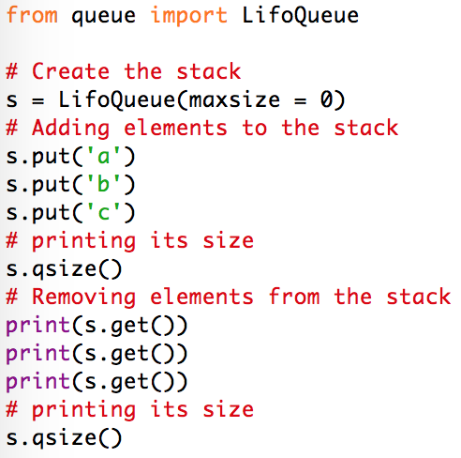
Data Structures
Implementing Stacks in Python
Data Structures: Lists, Stacks, and Queues
Using a built-in collection, for example, from queue package the LifoQueue class
Create the queue
constructor
Insert
s.put(d)
Remove and access
s = q.get()
Beware: calling get() to an empty stack may cause a wait behavior
Complete ref here

Slide 26
Data Structures
Implementing Stacks in Python
Data Structures: Lists, Stacks, and Queues
Using Python Lists
You use a Python list as a black box, you don’t know what is going on really, but it is simple
Using the LinkedList class saw in the previous class, or another implementation you own
You know what is going on, but you may not know if the implementation is the best possible one
Using a built-in collection, for example, from queue package the LifoQueue class
You know you are using an efficient and reliable tested implementation, but it may have features and details you do not need/want, or miss others you need/want

Slide 27

From Java to Python
What is a hash table
Data Structures: Dictionaries (and hash)
The basic table storage works pretty much as an array
If I want to access an element, for example john's information, I fetch the contents of a position in the table, for example [6] fetch john’s information
The problem is to know where the information is
I can search for john; or
I can use “john” to code where this information is
0
1
2 | paul | 1964
3 | george | 2012
4 | ringo | 2005
5
6 | john | 1952
7
8
9

Slide 28

From Java to Python
Have you heard about ASCII or UTF-8
Data Structures: Dictionaries (and hash)
ASCII table maps out 128 symbols, including letters, symbols, and punctuations used in English, digits, and some control characters into binary representations of 8-bits
It corresponds to numbers from 0 to 127
For example
uppercase letters go from 65 to 90
lowercase letters go from 97 to 122
digits go from 48 to 57
blank space is 32, hashtag is 35, …
UTF-8 (and UTF-16 too) is an extension of ASCII to encompass letters, punctuation, and symbol from other alphabets:
Açai, über, Γαλαξίας, ¿lo entiendes?, ثلاثة أربعة

Slide 29
From Java to Python
What is a hash table
Data Structures: Dictionaries (and hash)
You can hash an address using a key, and its ASCII/UTF-8 representation
You can use name as key
Get the ASCII code of the first letter and use its remainder of 10 (last digit)
ord("g") which is 103
ord("j") which is 106
ord("p") which is 112
ord("r") which is 114
ord(key[0]) % 10 is my hash function - a way to decide where to store and how to retrieve
0
1
2 | paul | 1964
3 | george | 2012
4 | ringo | 2005
5
6 | john | 1952
7
8
9

Slide 30


From Java to Python
What is a hash table
Data Structures: Dictionaries (and hash)
Hash table can have collisions …
If I want to include yoko
ord("y") is 121
If I want to include honey
ord("h") is 104
There are several ways to deal with collision
Separate channing
Linear probing
Quadratic probing
Double hashing
… and there is rehashing, specially when the table becomes crowded
0
1
2 | paul | 1964
3 | george | 2012
4 | ringo | 2005
5
6 | john | 1952
7
8
9

Slide 31
From Java to Python
What is a hash table
Data Structures: Dictionaries (and hash)
To find a good hash function is a complex process, but it generally works well giving reasonable sized tables
And there are always methods to cope with collisions
Most hash table algorithms encapsulate the implementation and are used as black boxes
This is the case of Python dictionaries
Hash maps, a similar structure to Hash tables, is also implemented using Python dictionaries, but Hash Maps are rarely used nowadays

Slide 32
From Java to Python
Python dictionaries
Data Structures: Dictionaries (and hash)
Basic syntax
BeatlesDic = {"john": 1952, \ "paul": 1964, "george": 2012, \ "ringo": 2005 }
Basic methods
Creating an empty dictionary
myDict = {}
Including new entries
myDict.update({key: value, key: value, …})
It creates as many new entries as you want
Retrieving entries
myDict.get(key, default)
It retrieves the value associated to an existent key, or default otherwise

Slide 33

From Java to Python
Python dictionaries
Data Structures: Dictionaries (and hash)
Some methods additional methods
keys()
Return all dictionary keys in a list
values()
Return all dictionary values in a list
items()
Return all tuples (key: value) in a list
for <var> in <dict>:
Iterates delivering all keys of <dict> in the variable <var>
del <dict>[<key>]
Removes the tuple with <key> from <dict>
<key> in <dict>
Returns True if <key> exists in <dict>
Abundant references on the Internet

Slide 34
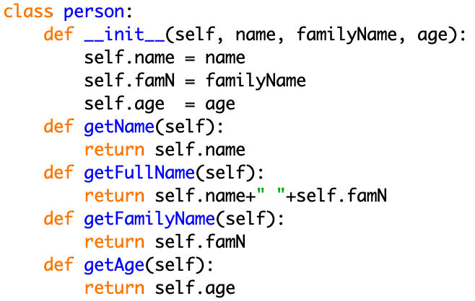
From Java to Python
Python dictionaries
Data Structures: Dictionaries (and hash)
An example of use (1 of 5)
Creating a dictionary with people on it

Slide 35
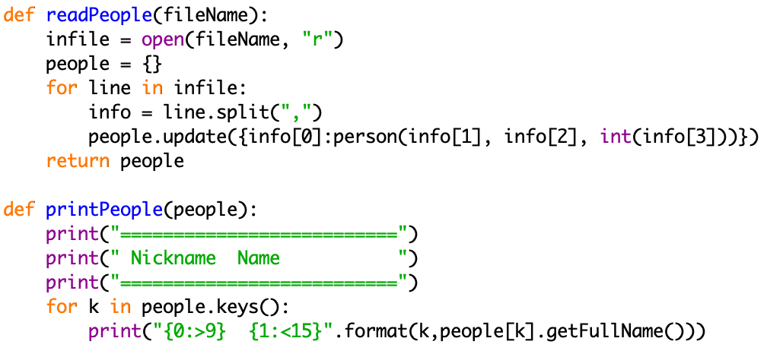
From Java to Python
Python dictionaries
Data Structures: Dictionaries (and hash)
An example of use (2 of 5)

Slide 36
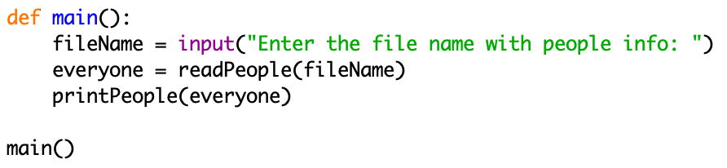
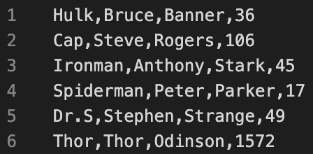
From Java to Python
Python dictionaries
Data Structures: Dictionaries (and hash)
An example of use (3 of 5)
avengers.csv
Download full code
Now run it!
Download data

Slide 37
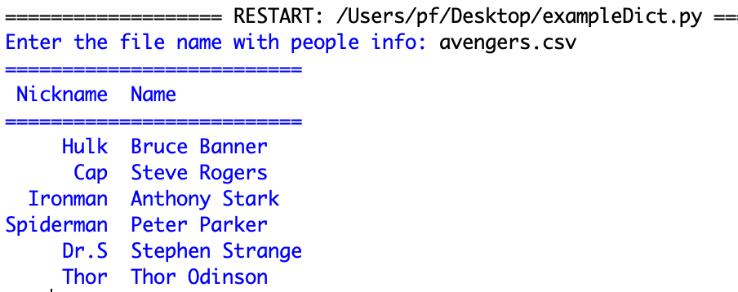

From Java to Python
Python dictionaries
Data Structures: Dictionaries (and hash)
An example of use (4 of 5)

Slide 38
From Java to Python
Python dictionaries
Data Structures: Dictionaries (and hash)
An example of use (5 of 5)
Now extend this example offering the user to verify the age of two avengers by informing their nickname
After the printingPeople function call, ask the user some input with the name of an avenger and print the avenger's age (do it twice)
This exercise is non-evaluated, just to get experience handling dictionaries

Slide 39
From Java to Python
Python dictionaries
Data Structures: Dictionaries (and hash)
Another example of use (1 of 3)
Counting the occurrences of words
Read all words from a file
Read the file
Get rid of punctuations
Create a list of words with repetition
Save unique words into a dictionary in tuples:
word : occurrences
(keep updating the occurrences)
Sort the unique words by frequency
Print the 20 more frequent words

Slide 40
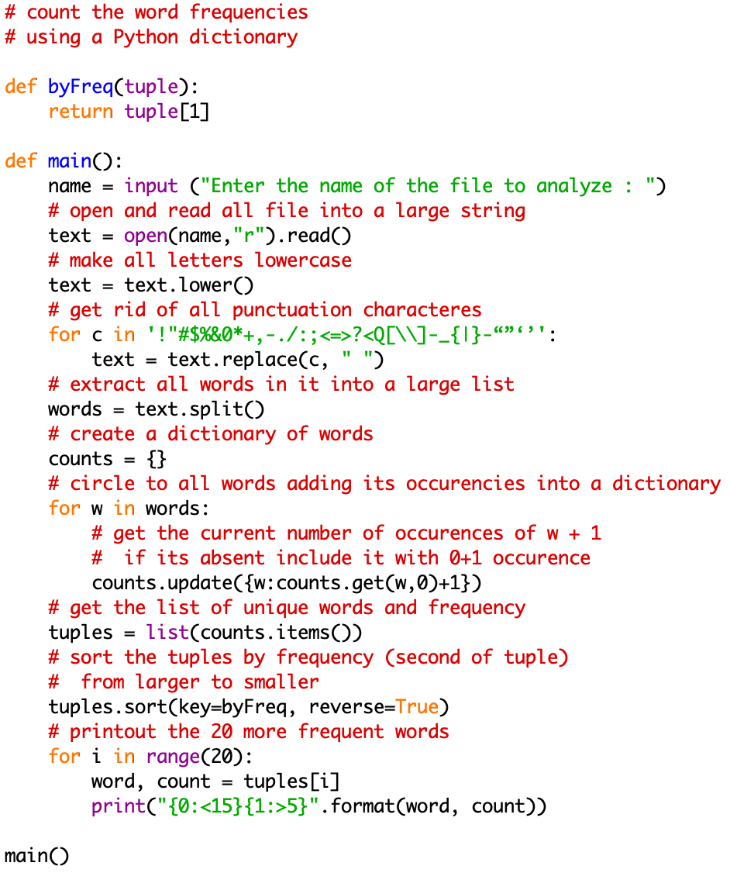
From Java to Python
Python dictionaries
Data Structures: Dictionaries (and hash)
Another example of use (2 of 3)
Read all words
Save tuples
word : frequency
Sort by frequency
Print 20 more frequent

Slide 41
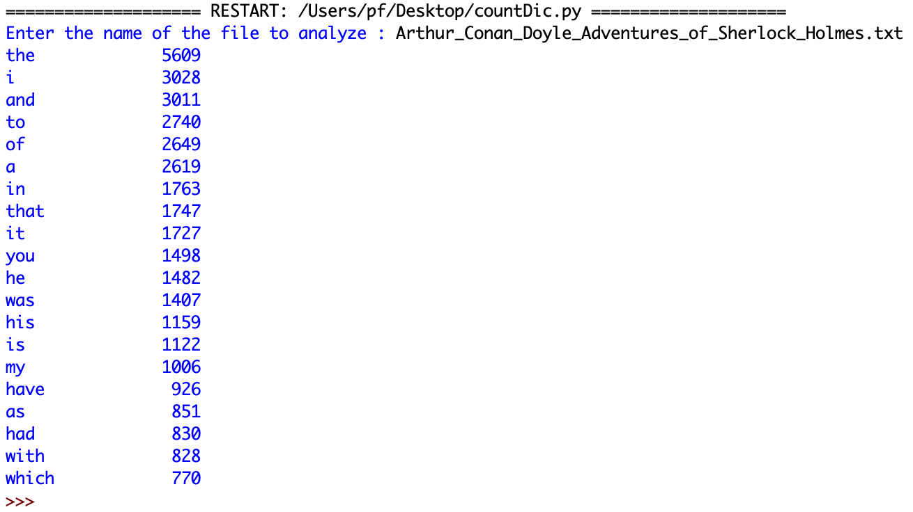
From Java to Python
Python dictionaries
Data Structures: Dictionaries (and hash)
Another example of use (3 of 3)
Testing over
Arthur Conan Doyle - Adventures of Sherlock Holmes
Download full code
Download data

Slide 42
From Java to Python
Project #2 - this week's Assignment
Second Assignment
Create a program that reads a list of people (use the class Person seem in class) from a file named people.csv (create your own file with about 15 fictional people)
Store those people in a stack (use any stack implementation you want among the ones presented in class)
Ask repeatedly the user integer numbers from 1 to 4, and according to the user informed number pop this amount of people, printing the name of the one remaining in the top of the stack
For example, if the user enters 2, it removes two people from the stack and print the "third" remaining in the stack
The program stops as the stack becomes empty

Slide 43
From Java to Python
Project #2 - this week's Assignment
Second Assignment
This program must be your own, do not use someone else’s code
Any specific questions about it, please bring to the Office hours meeting this Wednesday or contact me by email
This is a challenging program to make sure you are mastering Stacks in Python
Don’t be shy with your questions
Go to IDLE and try to program it
Save your program in a .py file and submit it in the appropriate delivery room
Deadline: Monday May 23 2022 11:59 PM EST

Slide 44
That’s all for today folks!
This week’s tasks
Next week
No tasks for the Worksheets this week
However, a lot of exercises to practice
Quiz #2 to be available this Friday
Deadline: Monday May 23 11:59pm
Project #2 assignment
Deadline: Monday May 23 11:59pm
Try all exercises seen in class and consult the reference sources, as the more you practice, the easier it gets
Data Structures
Trees
Graphs
Don’t let work pile up!
Don’t be shy about your questions
Have a Great Week!

